Slide 1
Pre-Placement Project ( dA153s15 )
By:
V.Sanjay

Slide 2

content
Objective
Introduction To Data
Data Cleaning And Preprocessing
Sql (Backup Of The Data)
Exploratory Data Analysis (Eda)
Data Visualization With Tableau
Business Questions
Challenges And Limitation
Conclusion

Slide 3
Objective
Utilize adidas sales data for in-depth analysis employing exploratory data analysis (EDA) techniques in python, MySQL, and tableau.
Through python, clean and prepare the data, conducting preliminary analysis to identify patterns and outliers.
Utilize MySQL for efficient data storage and querying, extracting valuable insights.
Finally, tableau to create interactive, visually appealing dashboards that highlight sales patterns, regional disparities, and product popularity.
The objective is to derive actionable insights from these analyses, driving strategic decisions to optimize inventory, refine marketing strategies, and enhance overall business performance for adidas.

Slide 4

Introduction to Data
This Adidas dataset offers a snapshot of vital retail elements such as sales figures, product categories, customer demographics, and regional insights.
By analysing this data, we delve into the intricate patterns of consumer behaviour, product performance, and market trends.
Our exploration encompasses python-based exploratory data analysis (EDA), meticulous data refinement in SQL, and dynamic visualizations in tableau.
Join us on this data-driven journey, where every data point tells a story, guiding strategic decisions and shaping the future of adidas sales strategies.

Slide 5

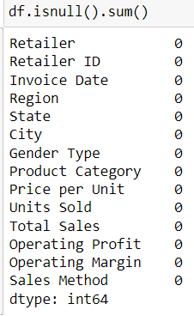
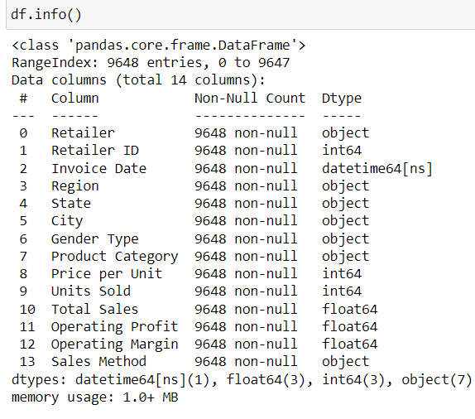
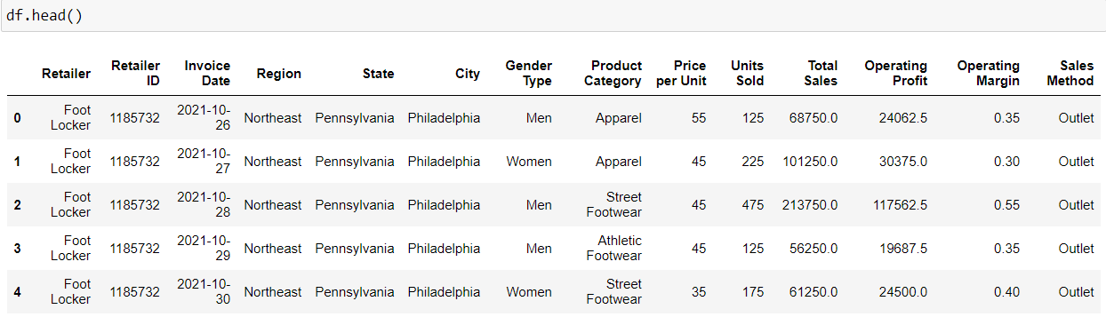
Data Cleaning and Preprocessing
.
Data loading: loaded adidas sales data from excel into python using pandas
Data Overview: Used shape function to determine the dataset's size (number of rows and columns).Utilized head() and tail() functions to observe the initial and final records of the dataset.
Data Inspection :Employed info() function to understand the data types of each column, crucial for analysis and processing.Checked for missing values using isnull(), ensuring the dataset is complete and ready for analysis.

Slide 6
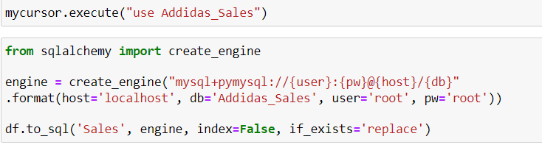
SQL ( Backup of the data )
Data Cleaning and Transformation : Utilized Python for rigorous data cleaning, ensuring accuracy and reliability. Employed techniques to handle missing values, outliers, and inconsistencies.
Database Integration : Established a secure connection to MySQL using SQL. Connector in Python. Created a dedicated database and transferred cleaned data, ensuring a structured backup.
SQL Queries for Insights : Executed SQL queries to extract specific insights from the "sales" table. Demonstrated the power of SQL in retrieving meaningful information from the dataset.
Data Integrity and Future Use: Ensured data integrity through thorough cleaning and secure storage in MySQL. Highlighted the database's future potential for robust and reliable analyses.

Slide 7
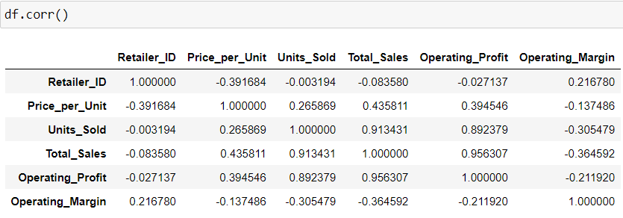
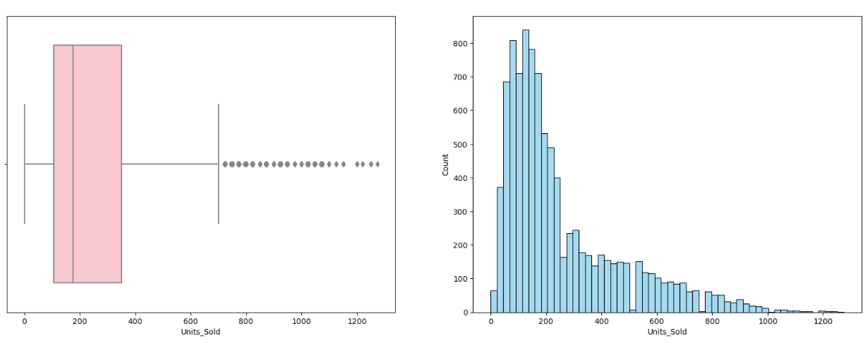
Exploratory Data Analysis (EDA) in Python
Data Loading and Segmentation:
Loaded cleaned data from CSV using pd.read_csv().
Separated data into numerical and categorical columns for analysis.
Univariate Analysis:
For Categorical Columns : Utilized Bar graphs and Pie charts to visually represent data distribution. Interacted with the audience to showcase different categories' proportions and frequencies.
For Numerical Columns: Employed Boxplots and Histograms for data spread visualization. Encouraged audience participation by discussing data ranges and central tendencies.
Bivariate Analysis: Identified suitable numerical columns using corr() for relationship exploration. Conducted interactive analysis with Scatter plots and Bar graphs. Engaged attendees in analysing relationships between variables. Encouraged audience feedback and interpretations for a participative session.

Slide 8
Data Visualization with Tableau
For to Create visualization in Tableau . I have loaded the cleaned data , which was cleaned with the help of python and make the cleaned into CSV file and load the data in Tableau
Then performed some task in Tableau .
After performing few tasks then I created a interactive Dashboard in the name of Adidas Sales dashboard . By clicking the choropleth map we can view the state wise sales , the action filter is applied to all the columns it will change when we click the particular place in the map
With the help of dashboard we can see which state has the highest sales , by which sales method the sales is high and so on

Slide 9
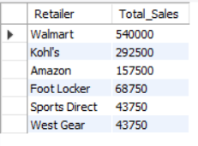
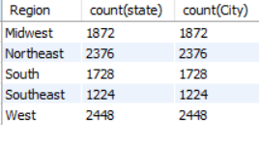
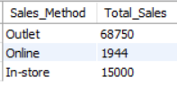
Business Questions and their Output (MySQL)
Retailer wise total amount of sales:
Walmart has the highest total sales , then Kohl’s and third is the
Amazon in the sales of Adidas product .
Region wise number of state and number of cities in each region
The west region has the highest number of state and cities compared to the other Region
Sales method wise Total Sales
The outlet sales method has the highest number of sales compare to online and In–store .

Slide 10
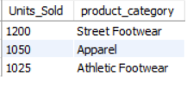
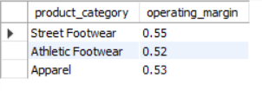
Units sold is greater than 1000 and their product_category name
The street Footwear category has the highest number of unit sold compared to other products .
Products profit_margin greater than 0.5
These are the products whose profit margin is greater than 0.5 . Profit margin is calculated before paying the Tax .

Slide 11
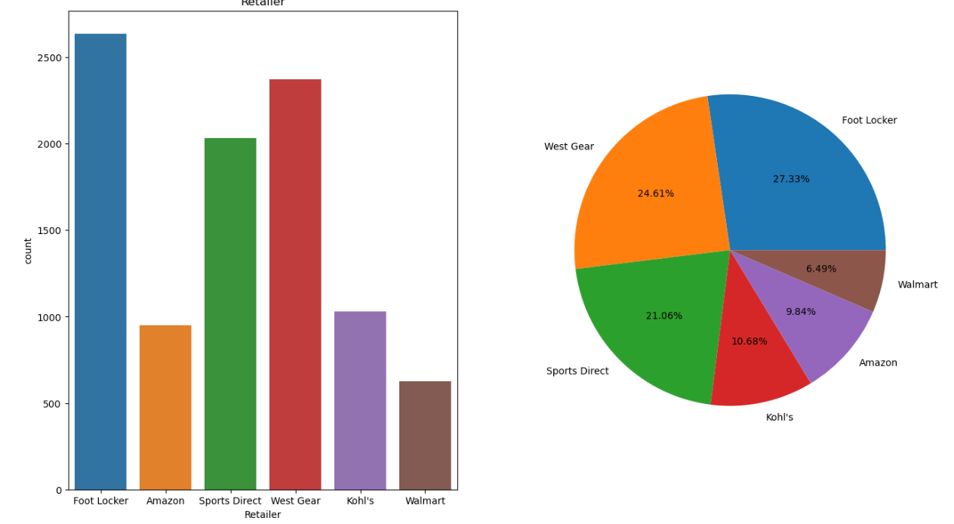
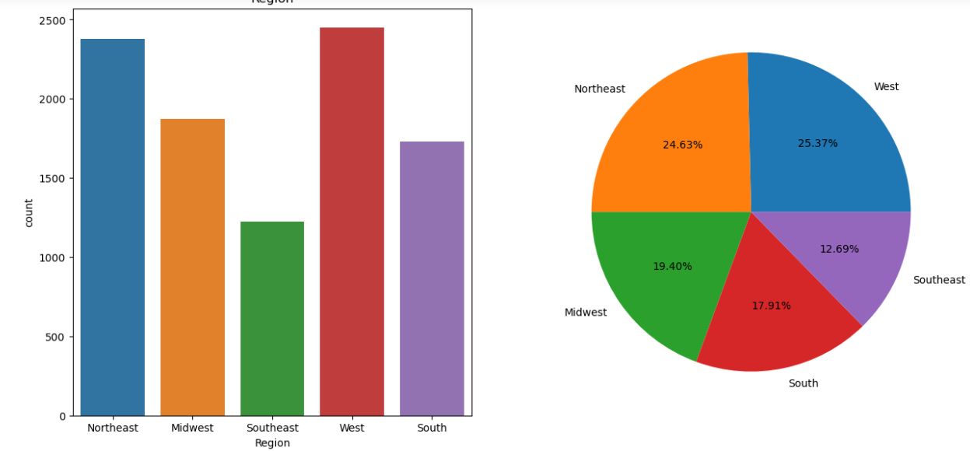
Business Questions and their Output (Python)
Analysis of Retailer
Here I displayed the number of Retailers and their play in market sales , Footlocker has the highest compared to others .
Analysis of Region
The west Region has the highest number of sales compared to other Region and followed by Northeast Region has the second highest number of sales .

Slide 12
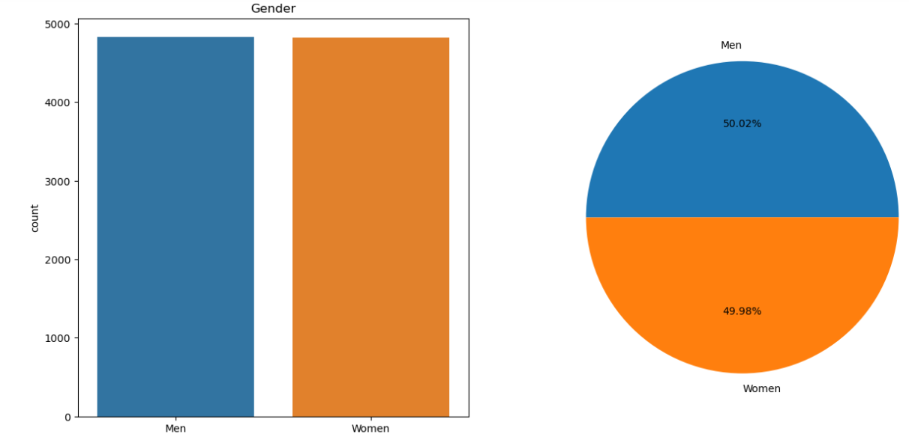
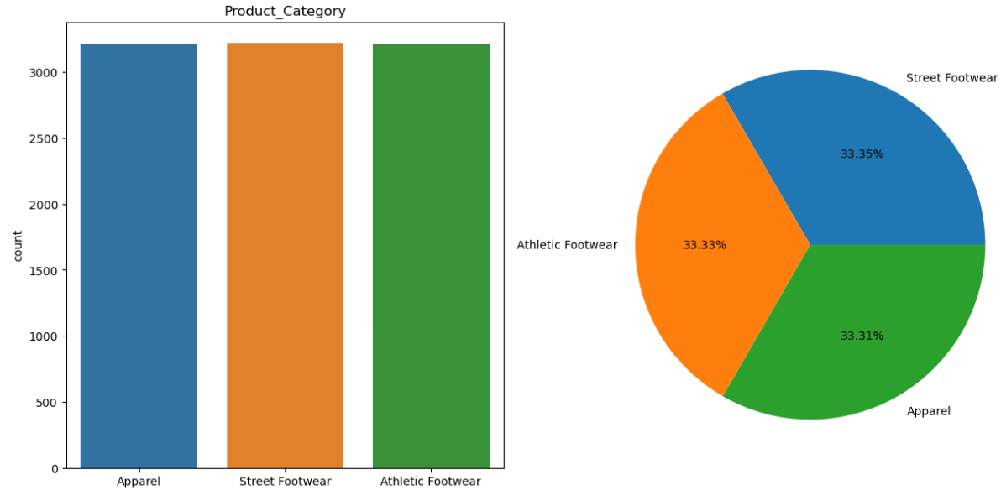
Analysis of Gender Type
Here we can see that there is no big difference in the gender because Men is 50.02 and Women is 48.98 , the difference is 0.4% .
Analysis of Product Category
Here the three product categories place a big role , the Street footwear has the highest sales but the difference between Street footwear and Athletic footwear is only 0.2 % and the same for athletic and Apparel .

Slide 13
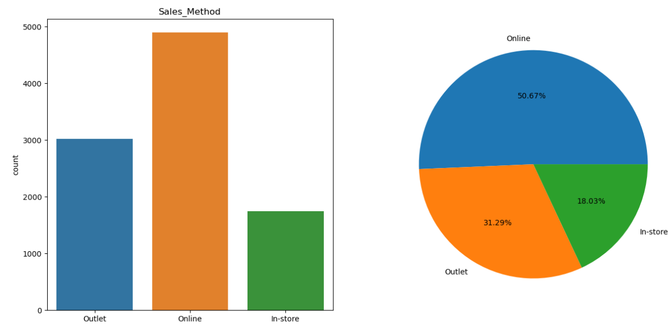
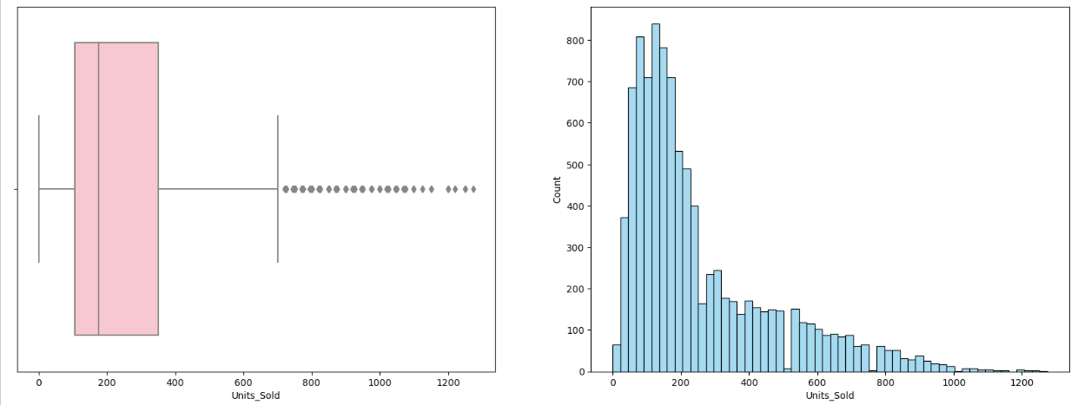
Analysis of Sales Method
Here we can see that the Online sales method has taken highest sales than compared to other sales Which is Outlet and In-Store .
Analysis of Unit Sold
The highest Units sold is between 100 to 300 approximately . We can see it by the Graph

Slide 14
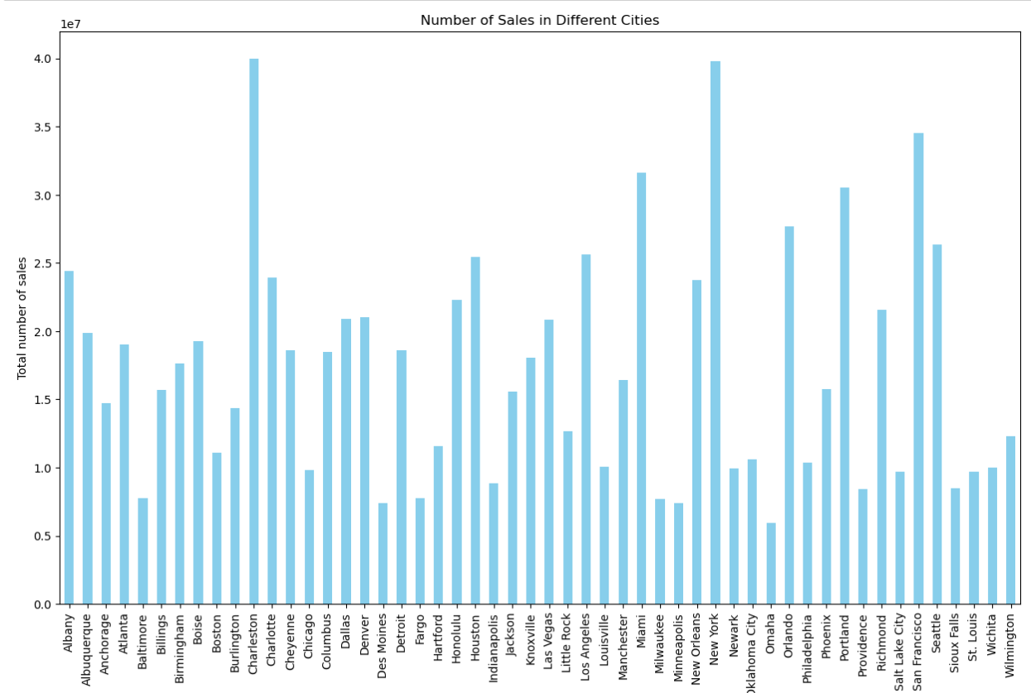
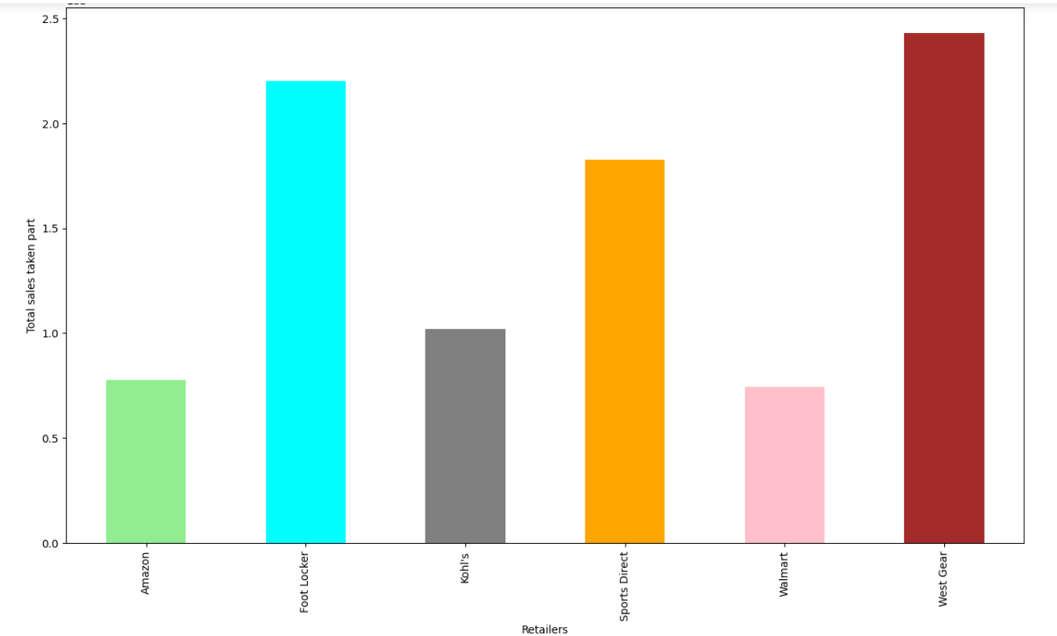
City wise Total number of Sales
Here the State of New York and Charleston has the high sales compared to other cities.
Retailer and their Total Sales
Here the Foot Locker and West Gear has the Maximum number of sales compared to other Retailers

Slide 15
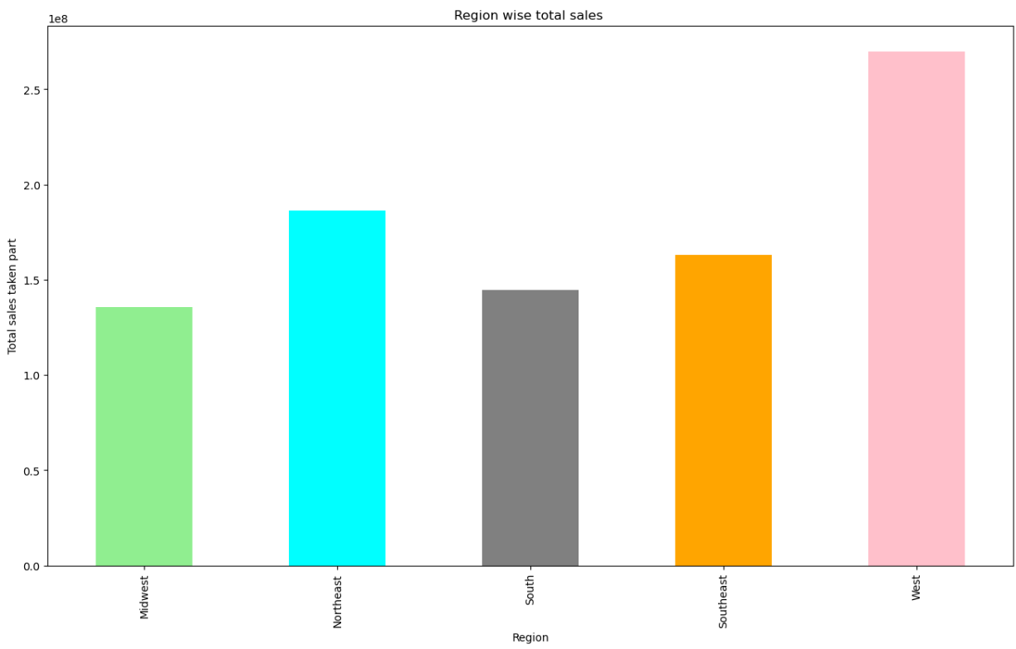
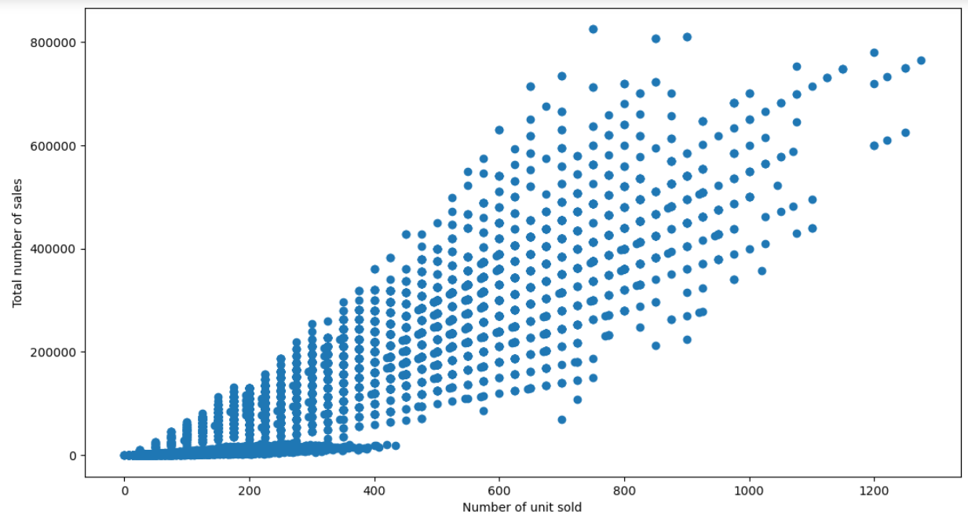
Region wise Total sales
Here we can see that the West Region has the Highest sales than other region .
Total unit sold and Total sales
Here we can see that the relation between Unit sold and Total sales has a positive relation because the scatter moves upwards .

Slide 16
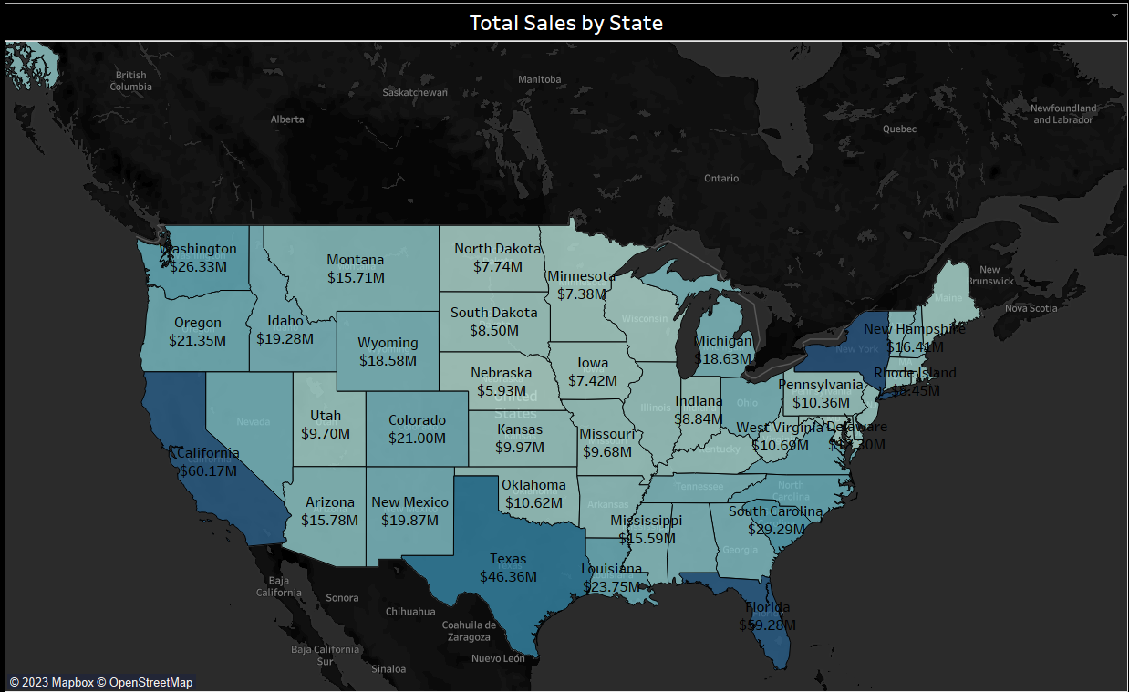
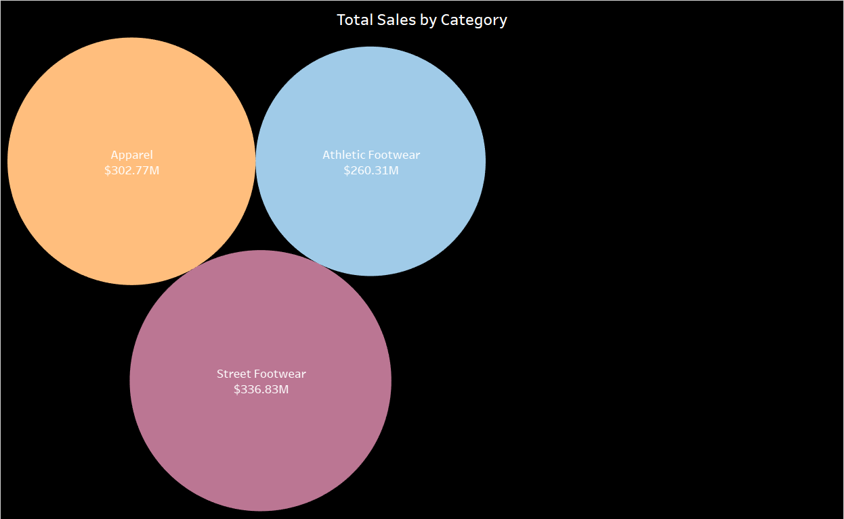
Business Questions and their Output (Tableau)
Total Sales by State
Here we can see the Total sales by each state
Total Sales by Category
Here we can see Total sales by each category

Slide 17
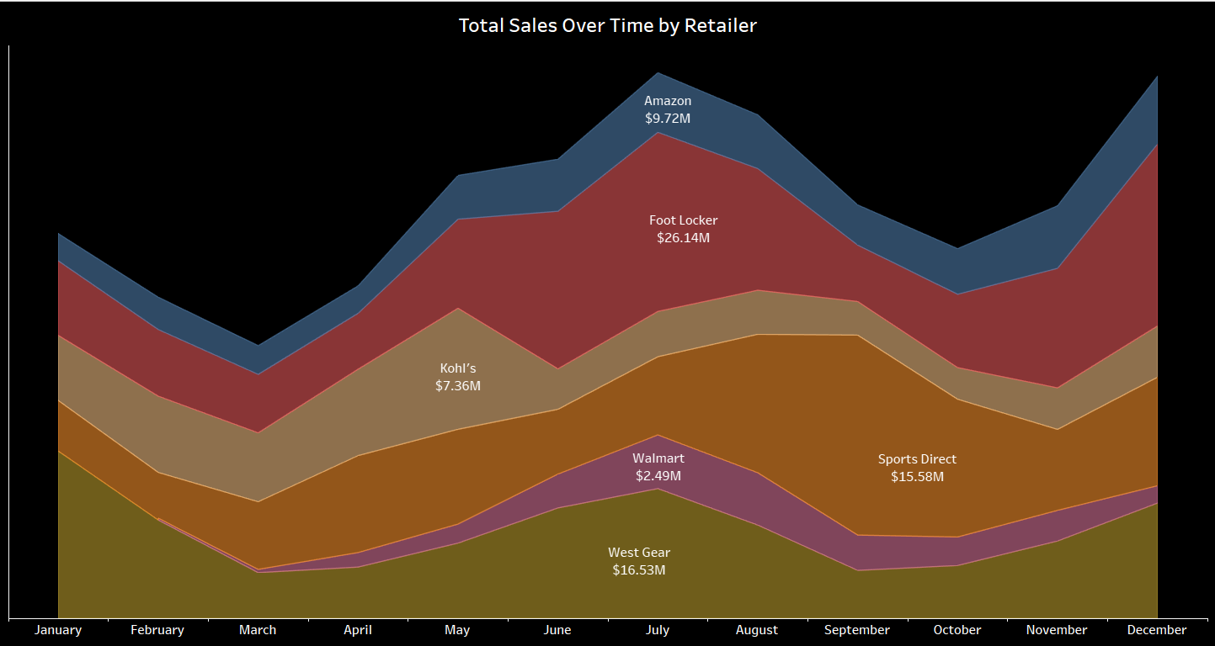
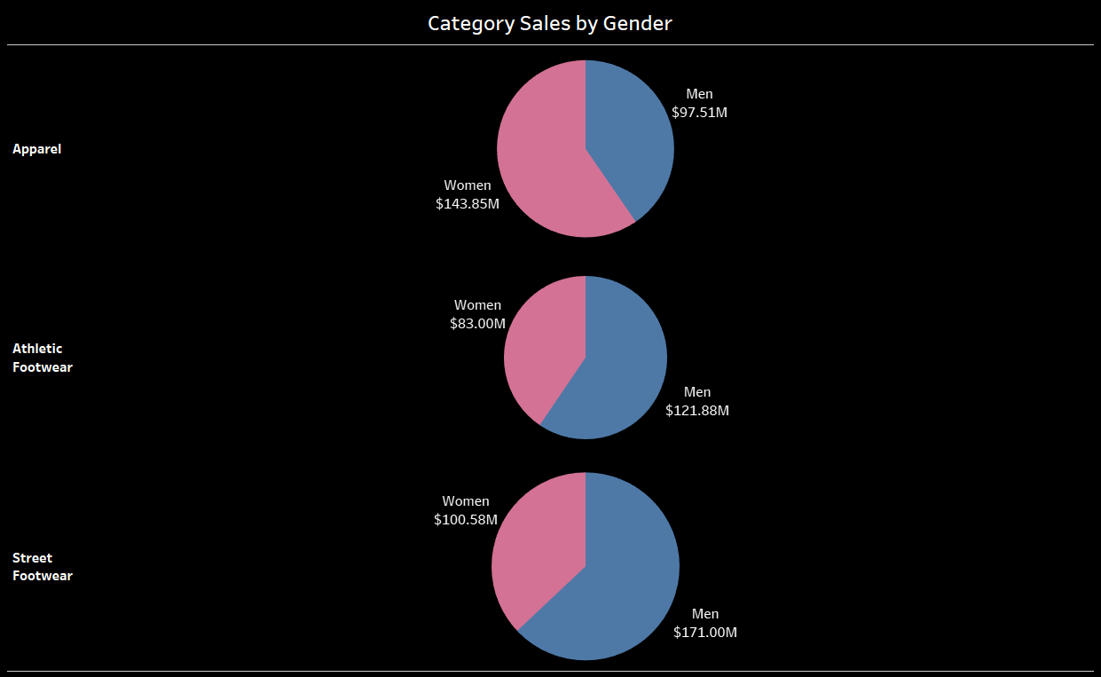
Total Sales over time by Retailer
Here we can see the Retailer wise Total sales over the time period
Category Sales by Gender
Here is the category wise sales by Gender

Slide 18
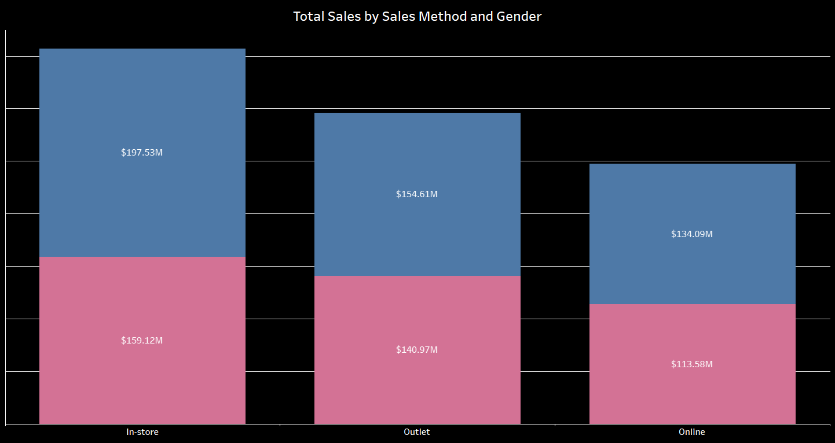
Total sales by Sales method and Gender

Slide 19
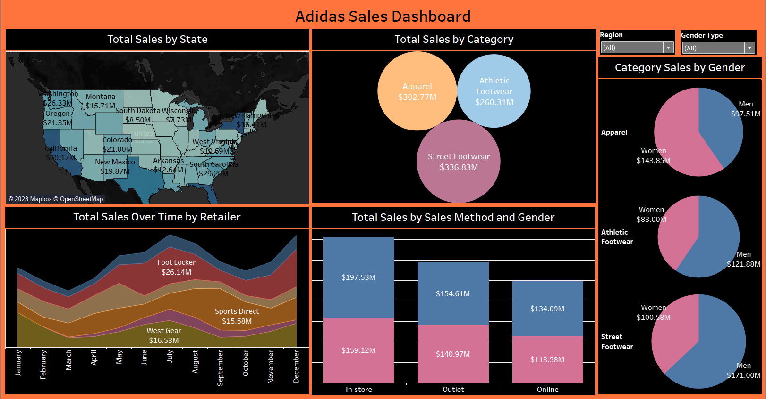

Slide 20
Challenges and limitation
Our findings provide A solid foundation for data-driven decision-making, allowing adidas to optimize marketing strategies, inventory management, and sales channels.
By identifying high-margin products and optimizing low-margin ones, we pave the way for improved profitability and sustainable growth.
The analysis is limited to the provided dataset columns. Additional data attributes could provide A more comprehensive understanding of the market.
The analysis relies on historical data, which might not fully capture evolving market trends or sudden shifts in consumer behavior, especially in rapidly changing markets.

Slide 21
conclusion
Our in-depth analysis equips adidas with actionable insights, ensuring strategic decisions are rooted in robust data.
Through exploratory and correlation analysis, we've identified operational inefficiencies, allowing for streamlined inventory management and resource
By focusing on high-margin products and optimizing marketing strategies, we are poised to enhance profitability and ensure sustainable growth.

Slide 22
THANK YOU

